Slide 1
All About Routing
CS 168 – Fall 2016 – Section 3

Slide 2
Agenda
Application
Transport
Ethernet Forwarding (L2)
Simple learning switches
Spanning tree protocol
Network (L3)
Link-state routing
Network
Datalink
Physical

Slide 3
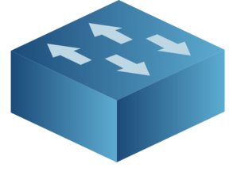

Forwarding
A packet with (source, destination) arrives at a switch
Where should the switch send the packet?
Packet Header
2
?
SRC | DEST
A | D
1
3
?
4
?

Slide 4
Forwarding
DEST | OUTGOING LINK
A | 1
D | 3
B | 2
The switch checks its forwarding table
Maps dest -> outgoing link
Packet Header
2
SRC | DEST
A | D
1
3
4

Slide 5
Forwarding
DEST | OUTGOING LINK
A | 1
D | 3
B | 2
DEST | OUTGOING LINK
A | 1
D | 3
B | 2
If the dest is found, send out that link!
Packet Header
2
SRC | DEST
A | D
1
3
4

Slide 6
Forwarding
DEST | OUTGOING LINK
A | 1
D | 3
B | 2
What if the dest is not found?
Could drop, flood, etc.
Packet Header
2
SRC | DEST
(ˆ(oo)ˆ) | ᄽὁȍ ̪őὀᄿ
1
3
4
Notes:
Pig and spider

Slide 7
Recall…
What makes a routing state valid?
For every destination:
If all paths to that destination have:
No dead-ends (except destination)
No loops
Then the state is valid

Slide 8

Spanning Trees
One way to solve loops:
Use a topology that doesn’t have any!
Spanning Tree
Used by Ethernet networks (L2)
Notes:
SPT protocol later, first talk about learning switches

Slide 9
Learning Switches
A
DEST | OUTGOING LINK
D | 3
B | 2
What if the dest is not found?
Flood!
In a spanning tree, this won’t cause loops
I don’t care
I don’t care
SRC | DEST
(ˆ(oo)ˆ) | ᄽὁȍ ̪őὀᄿ
2
1
3
A
(ˆ(oo)ˆ)
Wilbur’s in trouble!
4
I don’t care
I don’t care
ᄽὁȍ ̪őὀᄿ

Slide 10
Learning Switches
A
DEST | OUTGOING LINK
A | 1
D | 3
B | 2
DEST | OUTGOING LINK
D | 3
B | 2
(ˆ(oo)ˆ) | ?
What if the dest is not found?
Flood!
In a spanning tree, this won’t cause loops
We also learn where the src is!
SRC | DEST
(ˆ(oo)ˆ) | ᄽὁȍ ̪őὀᄿ
2
1
3
A
(ˆ(oo)ˆ)
4
ᄽὁȍ ̪őὀᄿ

Slide 11
Learning Switches
A
DEST | OUTGOING LINK
D | 3
B | 2
(ˆ(oo)ˆ) | 1
What if the dest is not found?
Flood!
In a spanning tree, this won’t cause loops
We also learn where the src is!
SRC | DEST
(ˆ(oo)ˆ) | ᄽὁȍ ̪őὀᄿ
2
1
3
A
(ˆ(oo)ˆ)
4
ᄽὁȍ ̪őὀᄿ

Slide 12
Learning Switch: Pseudocode
When a learning switch receives a packet:
Lookup the DEST in the switch table
if entry found for destination {
if dest on link from which packet arrived then drop packet
else forward packet on link indicated
}
else flood
Notes:
Inner if statement is used to prevent routers from being “locally stupid” and causing a back-and-forth loop

Slide 13
Spanning Tree Protocol (STP)
Goal:
To make this network…

Slide 14
Spanning Tree Protocol (STP)
Goal:
To make this network…
Function like this!

Slide 15
Spanning Tree Protocol (STP)
Algorithm in two parts:
Pick a root (by smallest Ethernet address)
Compute shortest paths to that root
Only keep the links on the shortest paths
Break ties by neighbor with smaller address
Notes:
Tie: if I get 2 messages with the same root and distance, one from router 3, the other one from router 4
-I choose the message/route given by router 3

Slide 16
Spanning Tree Protocol (STP)
Each router sends a message to its neighbors
(I think 4 is the root. My distance to 4 is 0. I am 4. )
Root, Distance, Src
When routers receive a message, they update their current knowledge of the root and distance to it.
If 4 receives (3, 0, 3):
It will now think (3 is the root. My distance is 1. I am 4.)
Repeat until everyone agrees

Slide 17










The Spanning Tree Battlefield
1
4
5
2
3
Day 1
6

Slide 18

The Spanning Tree Battlefield
1
4
5
2
3
Day 2
6
Notes:
Note: what if there was a link between router 2 and 3?
-Router 2 links to router 3 instead of router 5 (due to tiebreaker)

Slide 19

The Spanning Tree Battlefield
1
4
5
2
3
Day 3
6
Notes:
Note: what if there was a link between router 2 and 3?
-Router 2 links to router 3 instead of router 5 (due to tiebreaker)

Slide 20

The Spanning Tree Battlefield
1
4
5
2
3
Day 4: 1 Wins!
6

Slide 21
The Spanning Tree Battlefield
Now the links form a spanning tree...
And we can deploy our learning switches and flood!

Slide 22
Any questions?

Slide 23
Routing in the Network (L3)
Application
Transport
Goal: Compute the shortest routes
for all (source -> destination) pairs
Two main algorithms we‘ll discuss:
Link State Routing
Calculate on global topology
Distance Vector Routing
Project 2, out soon™!
Next section...
Network
Datalink
Physical

Slide 24
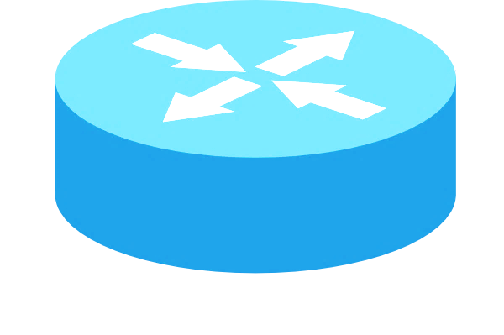
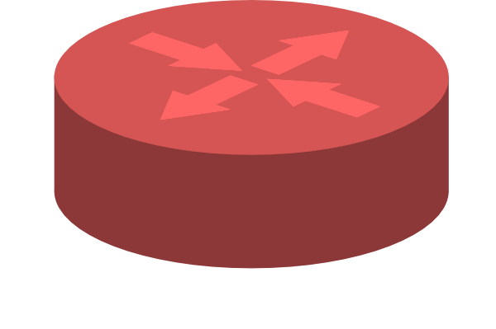
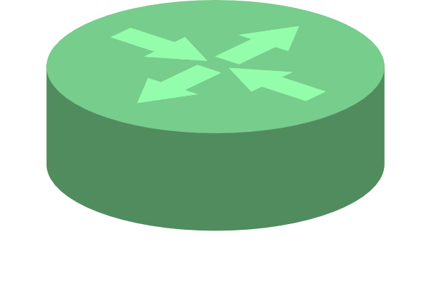
Link State Routing
Routers share info about their local neighbors
Together, they learn the global topology
Then compute the shortest paths themselves!
With Dijkstra‘s, etc.
1
4
2

Slide 25
Link State Routing
Routers share info about their local neighbors
Together, they learn the global topology
Then compute the shortest paths themselves!
With Dijkstra‘s, etc.
1
4
2

